Slide 1



Tranexamic acid safely reduces mortality
in bleeding trauma patients
Here we present the evidence

Slide 2
Millions bleed to death after trauma each year
There are millions of trauma deaths each year. Many patients survive to reach hospital. This slide shows the causes of in-hospital trauma deaths
Bleeding
45%
CNS injury
41%
Other
4%
Organ failure
10%

Slide 3
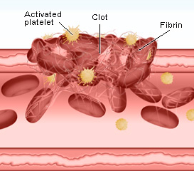
Coagulation and Fibrinolysis
In bleeding trauma patients:
Coagulation occurs rapidly at the site of damaged blood vessels.
Fibrinolysis breaks down blood clots.
In patients with serious bleeding fibrinolysis can make bleeding worse.

Slide 4
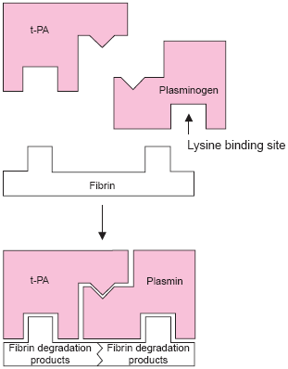
Fibrinolysis
Plasminogen activators from injured blood vessel convert plasminogen to plasmin.
Plasmin binds to the fibrin blood clot and breaks it down. This is fibrinolysis.

Slide 5
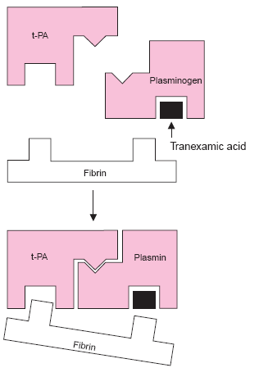
Tranexamic acid reduces fibrinolysis
Tranexamic acid inhibits plasmin and reduces clot breakdown.

Slide 6
Tranexamic acid reduces surgical bleeding
In surgical patients tranexamic acid (TXA) reduces the need for blood transfusion by about one third.
Need for transfusion
RR (95% CI)
TXA
0.61 (0.54–0 .69)
0.4
0.8
1.2
1.6
TXA better TXA worse

Slide 7
The CRASH-2 Trial
Tranexamic acid reduces clot breakdown
Tranexamic acid reduces bleeding in surgery
Many trauma patients die from bleeding
To see if tranexamic acid saves lives in bleeding trauma patients we conducted a very large Randomised Controlled Trial called CRASH-2

Slide 8
Methods
Over 20,000 bleeding trauma patients were randomly allocated to get tranexamic acid or matching placebo
We included all adult trauma patients who were within 8 hours of their injury, if their doctor thought that they had or could have significant haemorrhage
We then collected data on death in hospital within
4 weeks of injury and all important side effects

Slide 9
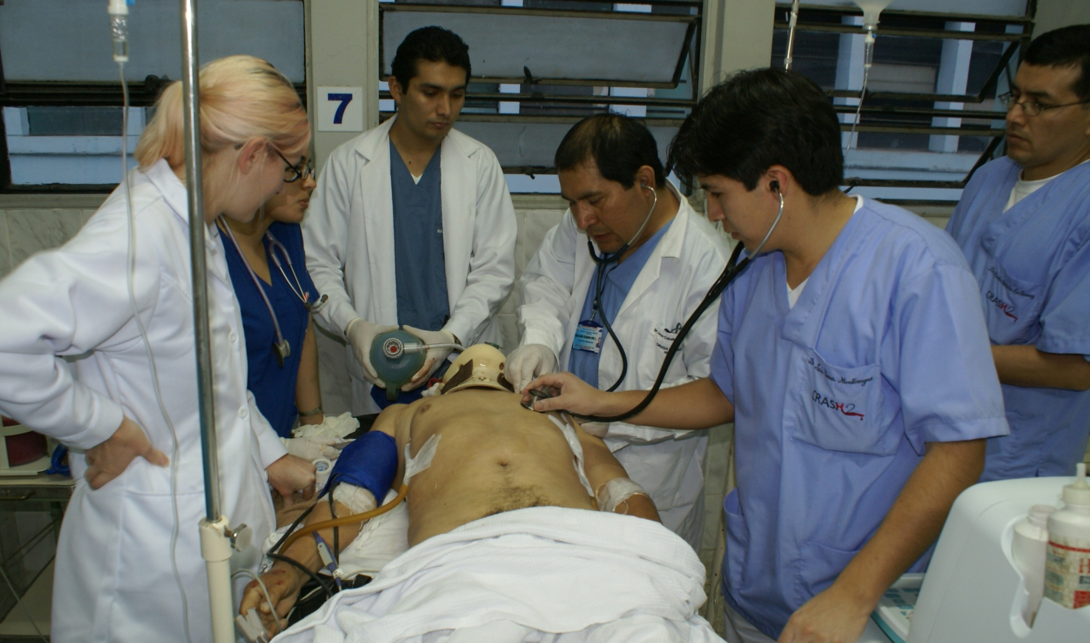

Slide 10
We used this dose of tranexamic acid
Treatment | Tranexamic acid dose
Loading | 1 gram over 10 minutes (by slow intravenous injection or an isotonic intravenous infusion)
Maintenance | 1 gram over 8 hours (in an isotonic intravenous infusion)

Slide 11





















We randomised many trauma patients
from 274 hospitals
20,211 patients
Patient enrolment
in 40 countries

Slide 12
We had excellent follow up
20,211 randomised
10,096 allocated TXA
10,115 allocated placebo
3 consent withdrawn
1 consent withdrawn
10,093 baseline data
10,114 baseline data
33 lost
to follow-up
47 lost
to follow-up
Followed up = 10,060 (99.7%)
Followed up = 10,067 (99.5%)

Slide 13
Baseline factors were well balanced
 | TXA n (%) | Placebo n (%)
Gender
Male | 8,439 (83.6) | 8,496 (84.0)
Female | 1,654 (16.4) | 1,617 (16.0)
[not known] | 0 | 1
Age (years)
<25 | 2,783 (27.6) | 2,855 (28.2)
25–34 | 3,012 (29.8) | 3,081 (30.5)
35–44 | 1,975 (19.6) | 1,841 (18.2)
>44 | 2,321 (23.0) | 2,335 (23.1)
[not known] | 2 | 2

Slide 14
Baseline factors were well balanced
 | TXA n (%) | Placebo n (%)
Time since injury (hours)
≤1 hour | 3,756 (37.2) | 3,722 (36.8)
>1 to ≤3 hours | 3,045 (30.2) | 3,006 (29.7)
>3 hours | 3,006 (29.7) | 3,380 (33.4)
[not known] | 5 | 6
Type of injury
Blunt | 6,812 (67.5) | 6,843 (67.7)
Penetrating | 3,281 (32.5) | 3,271 (32.3)

Slide 15
Baseline factors were well balanced
 | TXA n (%) | Placebo n (%)
Systolic Blood Pressure (mmHg)
>89 | 6,901 (68.4) | 6,791 (67.1)
76–89 | 1,615 (16.0) | 1,697 (16.8)
≤75 | 1,566 (15.5) | 1,608 (15.9)
[not known] | 11 | 18
Glasgow Coma Score
Severe (3–8) | 1,799 (17.8) | 1,839 (18.2)
Moderate (9–12) | 1,353 (13.4) | 1,351 (13.4)
Mild (13–15) | 6,934 (68.7) | 6,908 (68.3)
[not known] | 7 | 16

Slide 16
This is what we found
Cause of death TXA Placebo Risk of death P value
10,060 10,067
Bleeding 489 574 0.85 (0.76–0.96) 0.0077
Thrombosis 33 48 0.69 (0.44–1.07) 0.096
Organ failure 209 233 0.90 (0.75–1.08) 0.25
Head injury 603 621 0.97 (0.87–1.08) 0.60
Other 129 137 0.94 (0.74–1.20) 0.63
Any death 1463 1613 0.91 (0.85–0·97) 0·0035

Slide 17
Most of the benefit is for bleeding deaths
TXA (n= 10,060)
489 (4.9%)
Placebo (n= 10,067)
574 (5.7%)
RR (95% CI)
0.85 (0.76–0.96) 2P=0.0077
0.8
0.9
1.0
1.1
TXA better
TXA worse
Notes:
This is just reiterating the main effect on all cause mortality.
The bottom line is that this is very good news for trauma patients.
The vertical line crossing 1 signifies the line of no-effect.

Slide 18
For bleeding deaths – early treatment is better
RR (99% CI)
p=0.000008
≤1 hour
0.68 (0.54–0.86)
>1 to ≤ 3 hours
0.79 (0.60–1.04)
>3 hours
1.44 (1.04–1.99)
0.85 (0.76–0.96)
.7
.8
.9
1
1.1
1.2
1.3
1.4
1.5

Slide 19
Treatment must be given early because bleeding deaths happen soon after injury

Slide 20
There was no increase in thrombosis
TXA
allocated
(10,060)
Placebo
allocated
(10,067)
Risk ratio (95% CI)
DVT 40 (0.40%) 41 (0.41%)
PE 72 (0.69%) 71 (0.70%)
MI 35 (0.35%) 55 (0.52%)
Stroke 57 (0.56%) 66 (0.65%)
Any 168 (1.63%) 201 (1.95%)
.6
.7
.8
.9
1
1.1
1.2
TXA better
TXA worse

Slide 21
Tranexamic acid reduces symptoms
 | TXA [n=10060] | Placebo [n=10067] | RR (95% CI) | p-value
No symptoms | 1,483 (17.3%) | 1,334 (15.8%) | 1.11 (1.04 – 1.19) | 0.0023
Minor symptoms | 3,054 (30.4%) | 3,061 (30.4%) | 1.00 (0.96 – 1.04) | 0.94
Some restriction | 2,016 (20.0%) | 2,069 (20.6%) | 0.97 (0.92 – 1.03) | 0.36
Dependent | 1,294 (12.9%) | 1,273 (12.6%) | 1.02 (0.95 – 1.09) | 0.63
Fully dependent | 696 (6.9%) | 676 (6.7%) | 1.03 (0.93 – 1.14) | 0.57
Dead | 1,463 (14.5%) | 1,613 (16.0%) | 0.91 (0.85 – 0.97) | 0.0035

Slide 22
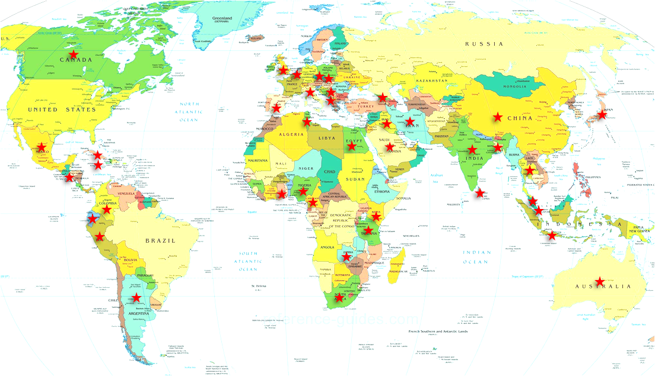
CRASH-2 was conducted on 4 continents and...
was shown to reduce mortality on each!

Slide 23
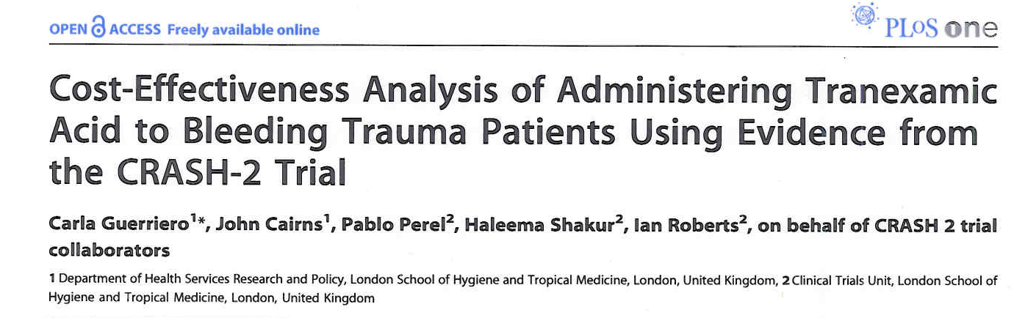
Tranexamic acid is highly cost effective

Slide 24
What we concluded
Tranexamic acid reduces mortality in bleeding trauma patients
Tranexamic acid does not seem to increase unwanted clotting
Tranexamic acid needs to be given early – within 3 hours of injury
Tranexamic acid is not expensive and could save hundreds of thousands of lives each year around the world

Slide 25
Tranexamic acid is now being used
After the CRASH-2 trial, tranexamic acid was added to the
WHO List of Essential Medicines (March 2011)
The military are using tranexamic acid to treat combat casualties
Tranexamic acid is being used in hospitals around the world
Tranexamic acid could be given in ambulances

